Slide 1
Project Presentation #5
Team E: Jiayu Yao, Shang Liu, Yuqiao Han

Slide 2
Goals
Features
Analyze factors that highly affect on Youtube video popularity.
Find out the top ten rules and attributes that contribute to high views on YouTube.
Input() features:
"channel frequency", "contain_facebook", "contain_instagram",
"tags_length", "daily_likes", "daily_dislikes", "daily_comment_count",
"title_length", "title_has_num", "title_has_special"
Output features:
"daily_views"

Slide 3
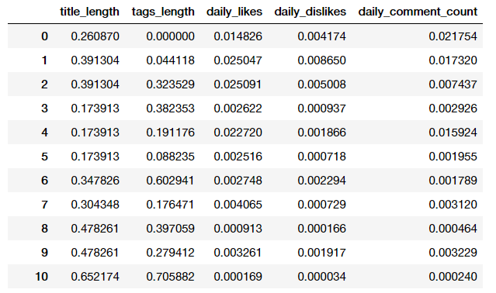
Feature Normalization

Slide 4
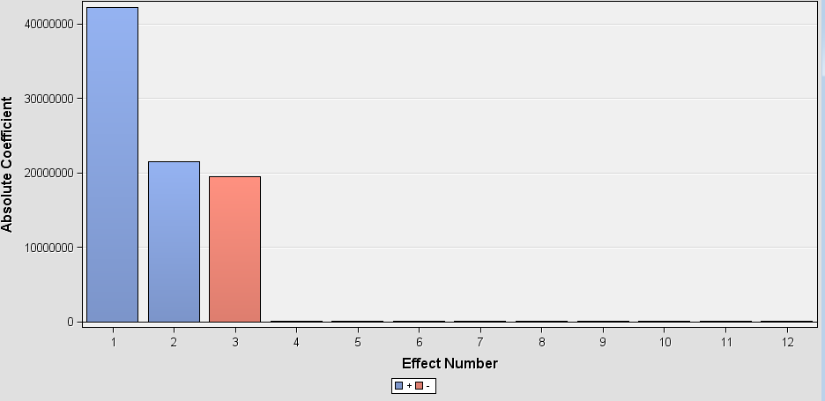
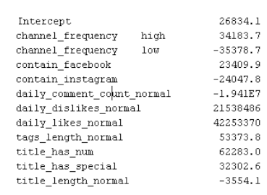
Linear Regression

Slide 5
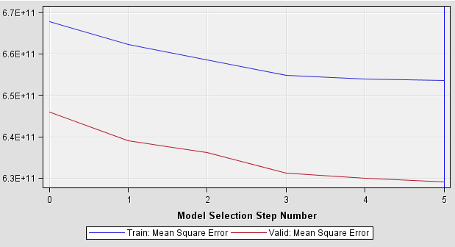
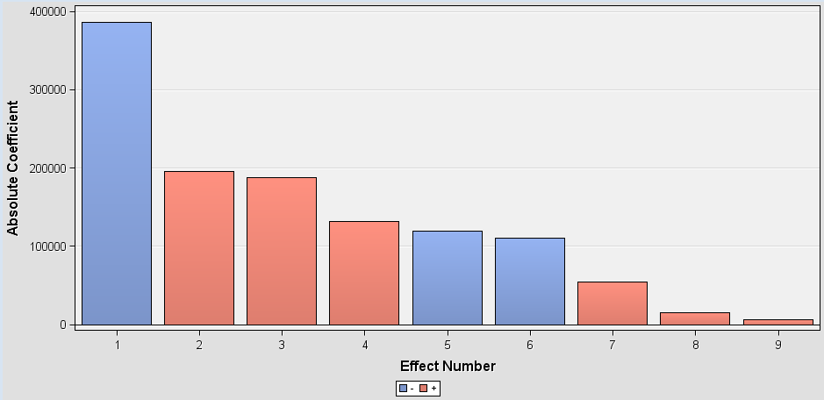
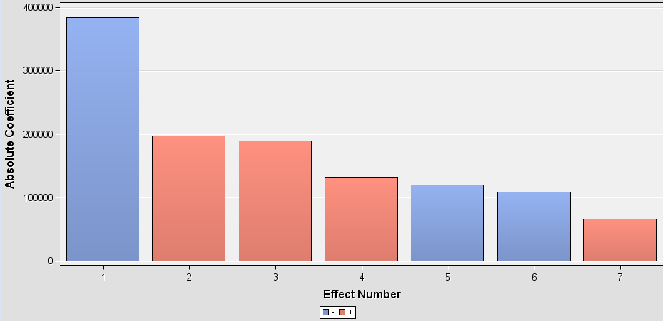
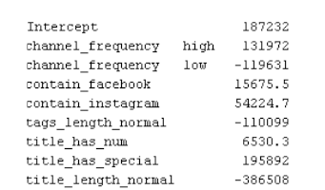
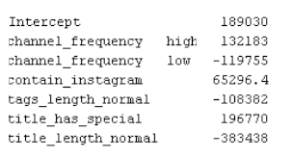
Linear Regression
no feature model selection
feature model selection

Slide 6
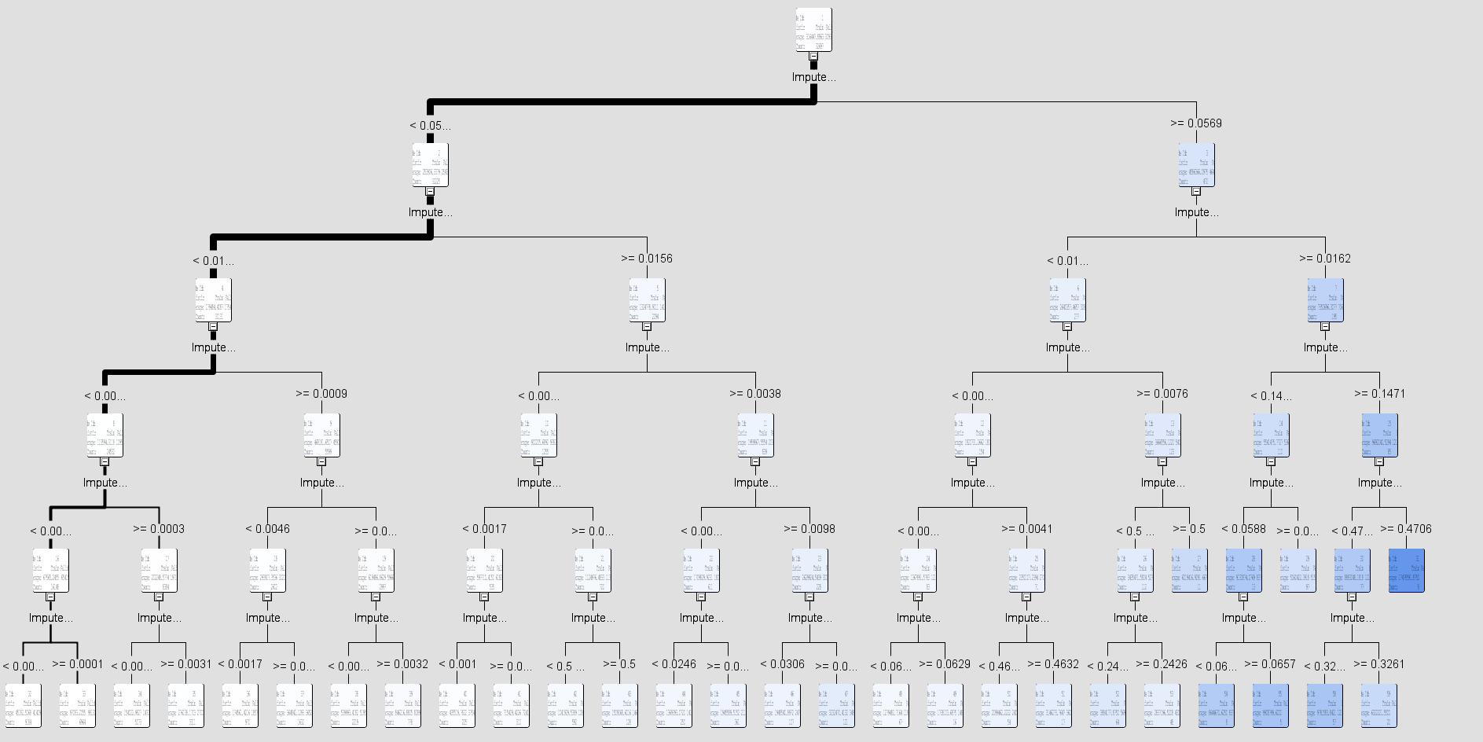
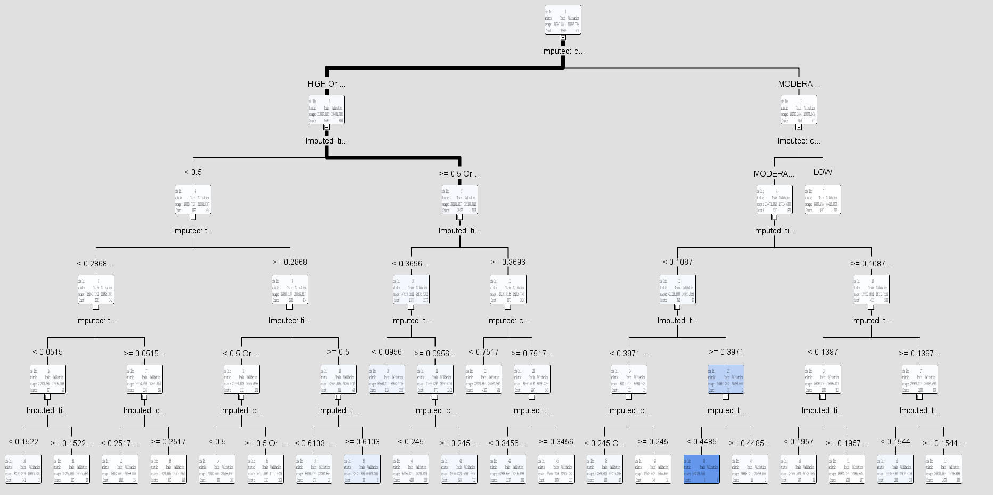
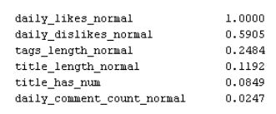
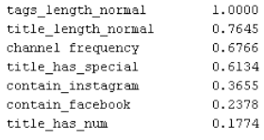
Decision Tree max:5
reduction in sum of squared errors from the predicted values

Slide 7
Decision Tree

Slide 8
Feedback from Professor
feature may have correlation
need more features

Slide 9
All Features
18 input features:
"title_length_normal", "tags_length_normal", "daily_likes_normal", "daily_dislikes_normal", "daily_comment_count_normal", "stop_words_count_title_normal", "stop_words_count_tags_normal", "hour_normal", "sub_date","channel frequency", "category_of_title_length", "tags_length_category", "description_contains_facebook", "description_contains_instagram", "title_contains_num", "title_contains_special", "title_contains_brackets", "has_description"
1 output feature:
"daily_view_classification","daily_views"

Slide 10
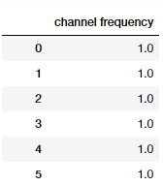
Channel Frequency
high -> 1.0
moderate -> 0.5
low -> 0

Slide 11
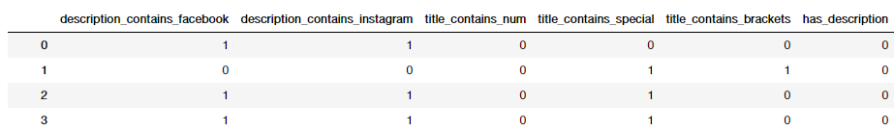
Binarylize

Slide 12
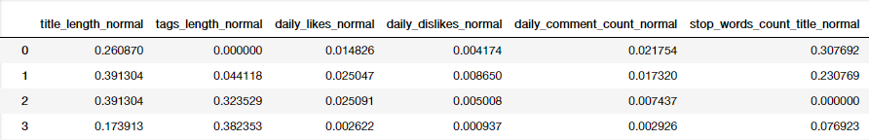
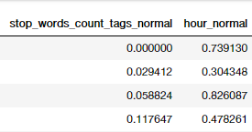
Normalize

Slide 13
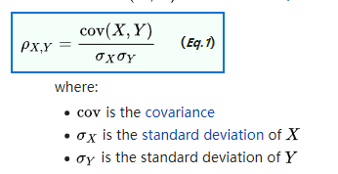
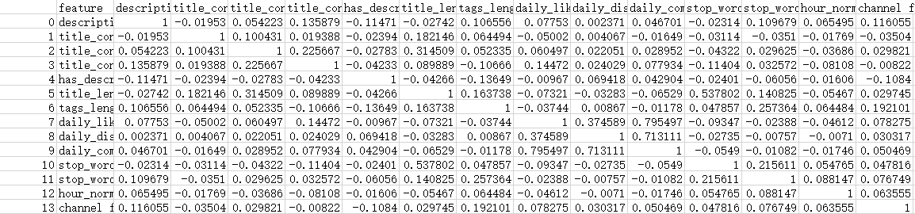
Pearson correlation coefficient

Slide 14
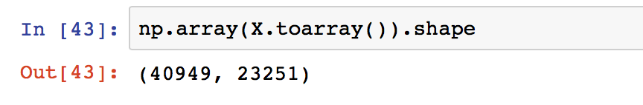
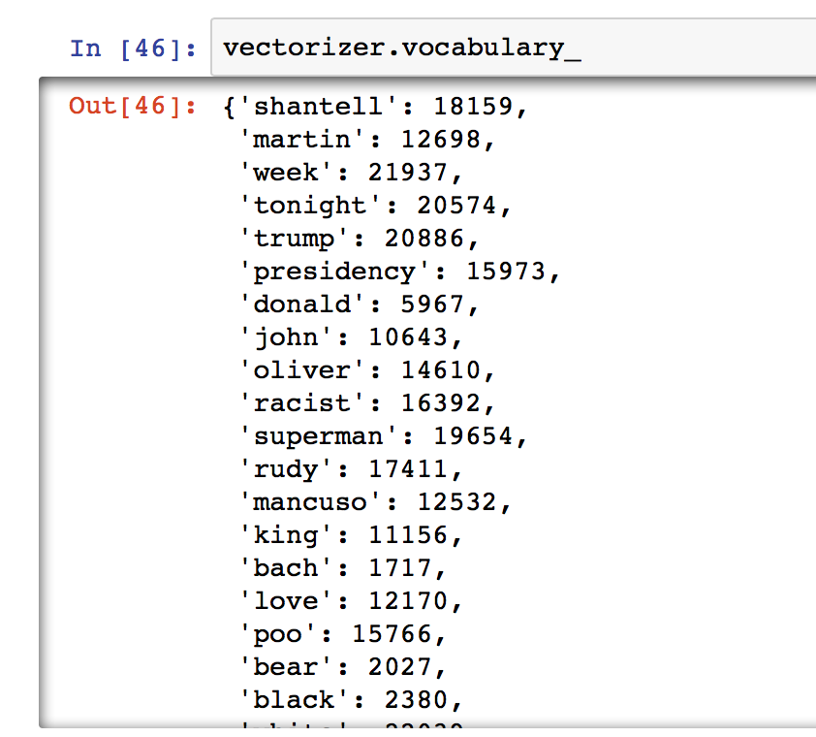
Bag of Words

Slide 15
Next Step
1. feature engineer
2. BoW
3.try linear regression(with feature selection, L2) again and plot scatter of prediction point(view, view_predict) and calculate R square
4.try decision tree again and get the importance
5.try association rule
6.Gradient boost
7.final report

